Slide 1
Introductory Statistics
Tenth Edition
Prem Mann
Chapter 5
Discrete random variables and their probability distributions
This slide deck contains animations. Please disable animations if they cause issues with your device.
Copyright ©2021 John Wiley & Sons, Inc.

Slide 2
Opening Example
Now that you know a little about probability, do you feel lucky enough to play the lottery? If you have $20 to spend on lunch today, are you willing to spend it all on four $5 lottery tickets to increase your chance of winning? Do you think you will profit, on average, if you continue buying lottery tickets over time? Can lottery players beat the state, on average? Not a chance! (See Case Study 5–1 for answers.)

Slide 3
5.1 Random Variables
Discrete Random Variable
Continuous Random Variable

Slide 4
Table 5.1 Frequency and Relative Frequency Distributions of the Number of Vehicles Owned by Families
Number of Vehicles Owned | Frequency | Relative Frequency
0 | 30 | 30/2000 = .015
1 | 320 | 320/2000 = .160
2 | 910 | 910/2000 = .455
3 | 580 | 580/2000 = .290
4 | 160 | 160/2000 = .080
 | N = 2000 | Sum = 1.000

Slide 5
Random Variables
Definition
A random variable is a variable whose value is determined by the outcome of a random experiment.

Slide 6
Discrete Random Variable
Definition
A random variable that assumes countable values is called a discrete random variable.

Slide 7
Examples of Discrete Random Variables
The number of cars sold at a dealership during a given month
The number of houses in a certain block
The number of fish caught on a fishing trip
The number of complaints received at the office of an airline on a given day
The number of customers who visit a bank during any given hour
The number of heads obtained in three tosses of a coin

Slide 8
Continuous Random Variable (1 of 2)
Definition
A random variable that can assume any value contained in one or more intervals is called a continuous random variable.

Slide 9
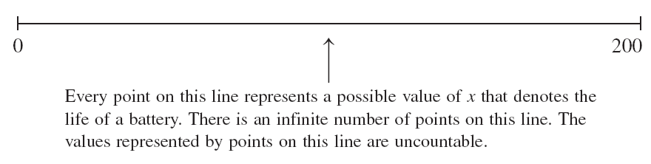
Continuous Random Variable (2 of 2)

Slide 10
Examples of Continuous Random Variables
The length of a room
The time taken to commute from home to work
The amount of milk in a gallon (note that we do not expect “a gallon” to contain exactly one gallon of milk but either slightly more or slightly less than one gallon)
The weight of a letter
The price of a house
Note that money is often treated as a continuous random variable, specifically when there are a large number of unique values.

Slide 11
5.2 Probability Distribution of a Discrete Random Variable
Definition
The probability distribution of a discrete random variable lists all the possible values that the random variable can assume and their corresponding probabilities.

Slide 12
Example 5-1
Recall the frequency and relative frequency distributions of the number of vehicles owned by families given in Table 5.1. That table is reproduced below as Table 5.2. Let x be the number of vehicles owned by a randomly selected family. Write the probability distribution of x and make a histogram for this probability distribution.

Slide 13
Table 5.2 Frequency and Relative Frequency Distributions of the Number of Vehicles Owned by Families
Number of Vehicles Owned | Frequency | Relative Frequency
0 | 30 | .015
1 | 320 | .160
2 | 910 | .455
3 | 580 | .290
4 | 160 | .080

Slide 14
Example 5-1: Solution Table 5.3 Probability Distribution of the Number of Vehicles Owned by Families
Number of Vehicles Owned x | Probability P (x)
0 | .015
1 | .160
2 | .455
3 | .290
4 | .080
 | ΣP(x) = 1.000

Slide 15
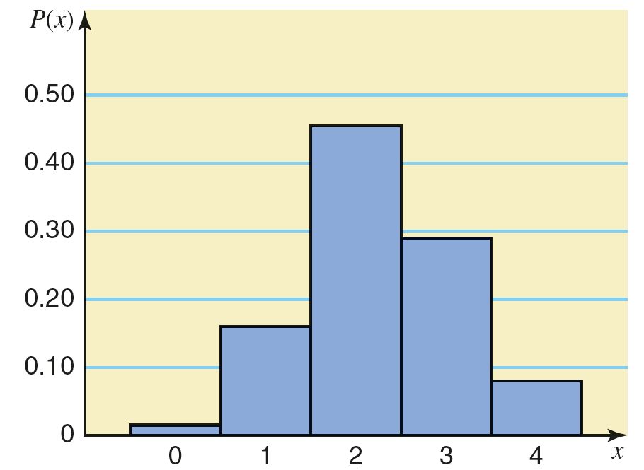
Example 5-1: Solution Figure 5.1 Histogram for the Probability Distribution of Table 5.3

Slide 16
Two Characteristics of a Probability Distribution
The probability distribution of a discrete random variable possesses the following two characteristics.
0 ≤ P(x) ≤ 1 for each value of x
Σ P(x) = 1

Slide 17
Example 5-2
Using the probability distribution listed in Table 5.3 of Example 5–1, find the following probabilities:
The probability that a randomly selected family owns two vehicles
The probability that a randomly selected family owns at least two vehicles
The probability that a randomly selected family owns at most one vehicle
The probability that a randomly selected family owns three or more vehicles

Slide 18
Example 5-2: Solution
Using the probabilities listed in Table 5.3,
P(selected family owns two vehicles) = P(2) = .455
P(selected family owns at least two vehicles) = P(2 or 3 or 4) = P(2) + P(3) + P(4) = .455 + .290 + .080 = .825
P(selected family owns at most one vehicle) = P(0 or 1) = P(0) + P(1) = .015 + .160 = .175
P(selected family owns three or more vehicles) = P(3 or 4) = P(3) + P(4) = .290 + .080 = .370

Slide 19
Example 5-3
Each of the following tables lists certain values of x and their probabilities. Determine whether or not each table represents a valid probability distribution.
(a)
x | P (x)
0 | .08
1 | .11
2 | .39
3 | .27
(b)
x | P (x)
2 | .25
3 | .34
4 | .28
5 | .13
(c)
x | P (x)
2 | .25
3 | .34
4 | .28
5 | .13

Slide 20
Example 5-3: Solution
No, since the sum of all probabilities is not equal to 1.0.
Yes.
No, since one of the probabilities is negative.

Slide 21
Example 5-4 (1 of 2)
The following table lists the probability distribution of the number of breakdowns per week for a machine based on past data.
Breakdowns per week | 0 | 1 | 2 | 3
Probability | .15 | .20 | .35 | .30

Slide 22
Example 5-4 (2 of 2)
Find the probability that the number of breakdowns for this machine during a given week is
exactly 2
0 to 2
more than 1
at most 1

Slide 23
Example 5-4: Solution Table 5.4 Probability Distribution of the Number of Breakdowns
Let x denote the number of breakdowns for this machine during a given week. Table 5.4 lists the probability distribution of x.
x | P (x)
0 | .15
1 | .20
2 | .35
3 | .30
 | ΣP(x) = 1.00

Slide 24
Example 5-4: Solution
Using Table 5.4,
P(exactly 2 breakdowns) = P(2) = .35
P(0 to 2 breakdowns) = P(0 ≤ x ≤ 2) = P(0 or 1 or 2)
= P(0) + P(1) + P(2)
= .15 + .20 + .35 = .70
P(more than 1 breakdown) = P(x > 1) = P(2 or 3)
= P(2) + P(3)
= .35 +.30 = .65
P(at most 1 breakdown) = P(x ≤ 1) = P(0 or 1)
= P(0) + P(1)
= .15 + .20 = .35

Slide 25
Example 5-5
According to a survey, 60% of all students at a large university suffer from math anxiety. Two students are randomly selected from this university. Let x denote the number of students in this sample who suffer from math anxiety. Construct the probability distribution of x.

Slide 26
Example 5-5: Solution
Let us define the following two events:
N = the student selected does not suffer from math anxiety
M = the student selected suffers from math anxiety
P(0) = P(NN) = .16
P(1) = P(NM or MN) = P(NM) + P(MN) = .24 + .24 = .48
P(2) = P(MM) = .36

Slide 27
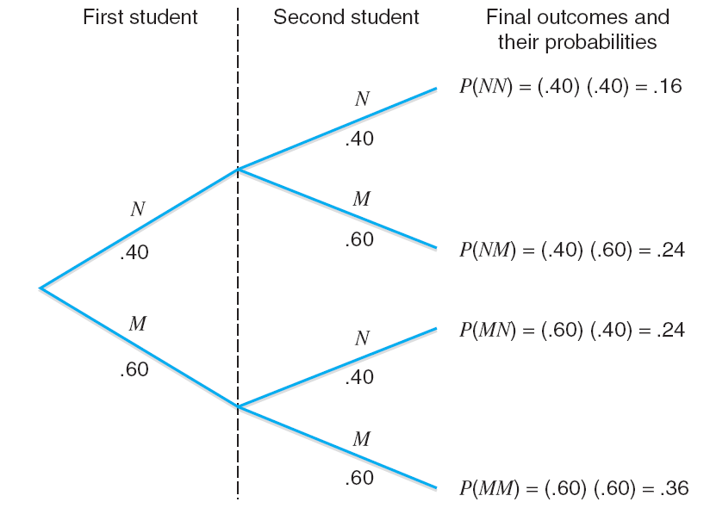
Example 5-5: Solution Figure 5.2 Tree Diagram

Slide 28
Table 5.5 Probability Distribution of the Number of Students with Math Anxiety
x | P (x)
0 | .16
1 | .48
2 | .36
 | ΣP(x) = 1.00

Slide 29
5.3 Mean and Standard Deviation of a Discrete Random Variable
The mean of a discrete variable x is the value that is expected to occur per repetition, on average, if an experiment is repeated a large number of times. It is denoted by µ and calculated as
µ = Σ x P(x)
The mean of a discrete random variable x is also called its expected value and is denoted by E(x); that is,
E(x) = Σ x P(x)

Slide 30
Example 5-6
The following table lists the number of breakdowns per week and their probabilities for a machine based on past data.
Breakdowns | Probability
0 | .15
1 | .20
2 | .35
3 | .30
Find the mean number of breakdowns per week for this machine.

Slide 31
Example 5-6: Solution Table 5.6 Calculating the Mean for the Probability Distribution of Breakdowns
x | P (x) | x P (x)
0 | .15 | 0(.15) = .00
1 | .20 | 1(.20) = .20
2 | .35 | 2(.35) = .70
3 | .30 | 3(.30) = .90
 |  | ΣxP(x) = 1.80
The mean is µ = Σx P(x) = 1.80

Slide 32
Standard Deviation of a Discrete Random Variable
The standard deviation of a discrete random variable x measures the spread of its probability distribution and is computed as

Slide 33

Case Study 5-1 All State Lottery

Slide 34
Example 5-7 (1 of 2)
Baier’s Electronics manufactures computer parts that are supplied to many computer companies. Despite the fact that two quality control inspectors at Baier’s Electronics check every part for defects before it is shipped to another company, a few defective parts do pass through these inspections undetected. Let x denote the number of defective computer parts in a shipment of 400. The following table gives the probability distribution of x.

Slide 35
Example 5-7 (2 of 2)
x | 0 | 1 | 2 | 3 | 4 | 5
P (x) | .02 | .20 | .30 | .30 | .10 | .08
Compute the standard deviation of x.

Slide 36
Example 5-7: Solution Table 5.7 Computations to Find the Standard Deviation
x | P (x) | x P (x) | x² | x ²P (x)
0 | .15 | .00 | 0 | .00
1 | .20 | .20 | 1 | .20
2 | .35 | .60 | 4 | 1.20
3 | .30 | .90 | 9 | 2.70
4 | .10 | .40 | 16 | 1.60
5 | .08 | .40 | 25 | 2.00
 |  | ΣxP(x) = 2.50 |  | Σx²P(x) = 7.70

Slide 37
Example 5-7: Solution
µ = ΣxP (x) = 2.50 defective computer parts in 400
Σx²P(x) = 7.70
= 1.204 defective computer parts

Slide 38
Example 5-8
Loraine Corporation is planning to market a new makeup product. According to the analysis made by the financial department of the company, it will earn an annual profit of $4.5 million if this product has high sales and an annual profit of $ 1.2 million if the sales are mediocre, and it will lose $2.3 million a year if the sales are low. The probabilities of these three scenarios are .32, .51 and .17 respectively.
Let x be the profits (in millions of dollars) earned per annum from this product by the company. Write the probability distribution of x.
Calculate the mean and the standard deviation of x.

Slide 39
Example 5-8: Solution (1 of 2)
The table below lists the probability distribution of x. Note that because x denotes profits earned by the company, the loss is written as a negative profit in the table.
x | P (x)
4.5 | .32
1.2 | .51
−2.3 | .17

Slide 40
Example 5-8: Solution (2 of 2)
Table 5.8 shows all the calculations needed for the computation of the mean and standard deviations of x.
µ = ΣxP (x) = $1.661 million
= $2.314 million

Slide 41
Table 5.8 Computations to Find the Mean and Standard Deviation
x | P (x) | x P (x) | x² | x ²P (x)
4.5 | .32 | 1.440 | 20.25 | 6.4800
1.2 | .51 | .612 | 1.44 | .7344
−2.3 | .17 | −.391 | 5.29 | .8993
 |  | ΣxP(x) = 1.661 |  | Σx²P(x) = 8.1137

Slide 42
Interpretation of the Standard Deviation
The standard deviation of a discrete random variable can be interpreted or used the same way as the standard deviation of a data set in Section 3.4 of Chapter 3.

Slide 43
5.4 The Binomial Probability Distribution
The Binomial Experiment
The Binomial Probability Distribution and Binomial Formula
Using the Table of Binomial Probabilities
Probability of Success and the Shape of the Binomial Distribution
Mean and Standard Deviation of the Binomial Distribution

Slide 44
The Binomial Experiment
Conditions of a Binomial Experiment
A binomial experiment must satisfy the following four conditions.
There are n identical trials.
Each trail has only two possible outcomes (or events).
The probabilities of the two outcomes (or events) remain constant for each trial.
The trials are independent.

Slide 45
Example 5-9
Consider the experiment consisting of 10 tosses of a coin. Determine whether or not it is a binomial experiment.

Slide 46
Example 5-9: Solution
There are a total of 10 trials (tosses), and they are all identical. Here, n=10.
Each trial (toss) has only two possible outcomes: a head and a tail.
The probability of obtaining a head (a success) is ½ and that of a tail (a failure) is ½ for any toss. That is,
p = P(H) = ½ and q = P(T) = ½
The trials (tosses) are independent.
Consequently, the experiment consisting of 10 tosses is a binomial experiment.

Slide 47
Example 5-10
Seventy five percent of students at a college with a large student population use Instagram. A sample of five students from this college is selected, and these students are asked whether or not they use Instagram. Is this experiment a binomial experiment?
In a group of 12 students at a college, 9 use Instagram. Five students are selected from this group of 12 and are asked whether or not they use Instagram. Is this experiment a binomial experiment?

Slide 48
Example 5-10: Solution (1 of 3)
We check whether all four conditions of the binomial probability distribution are satisfied.
This example consists of five identical trials.
Each trial has two outcomes: a student uses Instagram or a student does not use Instagram.
The probability p that a student uses Instagram is .75. The probability q that a student does not use Instagram is .25.
Each trial (student) is independent.
Because all four conditions of a binomial experiment are satisfied, this is an example of a binomial experiment.

Slide 49
Example 5-10: Solution (2 of 3)
(b)
This example consists of five identical trials.
Each trial has two outcomes: a student uses Instagram or a student does not use Instagram.
The probability p is that a student uses Instagram. The probability q is that a student does not use Instagram. They do not remain constant for each selection. The probability of each outcome changes with each selection depending on what happened in the previous selections.

Slide 50
Example 5-10: Solution (3 of 3)
(b)
Because p and q do not remain constant for each selection, the trials are not independent.
Given that the third and fourth conditions of a binomial experiment are not satisfied, this is not an example of a binomial experiment.

Slide 51
The Binomial Probability Distribution and Binomial Formula
For a binomial experiment, the probability of exactly x successes in n trials is given by the binomial formula
where
n = total number of trials
p = probability of success
q = 1 – p = probability of failure
x = number of successes in n trials
n − x = number of failures in n trials

Slide 52
Example 5-11
Seventy five percent of students at a college with a large student population use the social media site Instagram. Three students are randomly selected from this college. What is the probability that exactly two of these three students use Instagram?

Slide 53
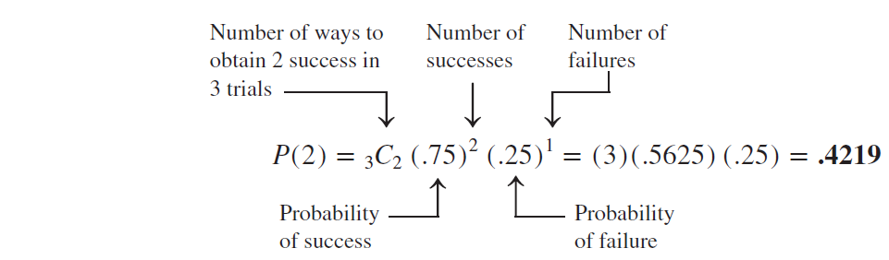
Example 5-11: Solution
Here, we are given that:
n = 3, x = 2, and p = .75
The probability of two successes is denoted by P(x=2) or P(2).

Slide 54
Example 5-12 (1 of 2)
At the Express House Delivery Service, providing high-quality service to customers is the top priority of the management. The company guarantees a refund of all charges if a package it is delivering does not arrive at its destination by the specified time. It is known from past data that despite all efforts, 2% of the packages mailed through this company do not arrive at their destinations within the specified time. Suppose a corporation mails 10 packages through Express House Delivery Service on a certain day.

Slide 55
Example 5-12 (2 of 2)
Find the probability that exactly one of these 10 packages will not arrive at its destination within the specified time.
Find the probability that at most one of these 10 packages will not arrive at its destination within the specified time.

Slide 56
Example 5-12: Solution (1 of 3)
n = total number of packages mailed = 10 p = P(success) = .02 q = P(failure) = 1 – .02 = .98

Slide 57
Example 5-12: Solution (2 of 3)
x = number of successes = 1 n – x = number of failures = 10 – 1 = 9
(a)
= (10)(.02) (.83374776) = .1667
Thus, there is a .1667 probability that exactly one of the 10 packages mailed will not arrive at its destination within the specified time.

Slide 58
Example 5-12: Solution (3 of 3)
(b) At most one of the ten packages is given by the sum of the probabilities of x = 0 and x = 1
P(x ≤ 1) = P(x = 0) + P(x = 1)
=₁₀ C₀ (.20)⁰(.98)¹⁰ +₁₀ C₁(.20)¹(.98)⁹
=(1)(1)(.81707281) + (10) (.02) (.83374776)
=.8171 + .1667 = .9838
Thus, the probability that at most one of the 10 packages mailed will not arrive at its destination within the specified time is .9838.

Slide 59
Example 5-13
According to a survey, 33% of American employees do not plan to change their jobs in the near future. Let x denote the number of employees in a random sample of three American employees who do not plan to change their jobs in the near future. Write the probability distribution of x and draw a histogram for this probability distribution.

Slide 60
Example 5-13: Solution (1 of 2)
n = total employees in the sample = 3
p = P(an employee does not plan to change his/her job in the near future) = .33
q = P(an employee does plan to change his/her job in the near future)
= 1 − .33 = .67

Slide 61
Example 5-13: Solution (2 of 2)
P(0) =₃ C₀ (.33)⁰(.67)³ = (1)(1)(.300763) = .3008
P(1) =₃ C₁ (.33)¹(.67)² = (3)(.33)(.4489) = .4444
P(2) =₃ C₂ (.33)²(.67)¹ = (3)(.1089)(.67) = .2189
P(3) =₃ C₃ (.33)³(.67)⁰ = (1)(.035937)(1) = .0359

Slide 62
Example 5-13: Solution Table 5.9 Probability Distribution of x
Table 5.9 Probability Distribution of x
x | P (x)
0 | .3008
1 | .4444
2 | .2189
3 | .0359

Slide 63
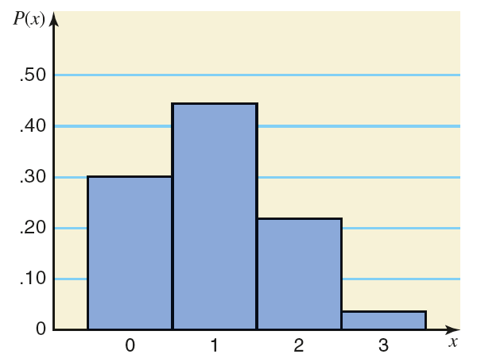
Figure 5.3 Histogram for the Probability Distribution of Table 5.9

Slide 64
Using the Table of Binomial Probabilities
The probabilities for a binomial experiment can also be read from Table I in Appendix B, the table of binomial probabilities.
This lists the probabilities of x for n = 1 to n = 25.
This lists the probabilities of x for selected values of p.

Slide 65
Example 5-14 (1 of 3)
According to a survey, 30% of college students said that they spend too much time on Facebook. (The remaining 70% said that they do not spend too much time on Facebook or had no opinion.) Suppose this result holds true for the current population of all college students. A random sample of six college students is selected. Using Table I of Appendix B, answer the following.

Slide 66
Example 5-14 (2 of 3)
Find the probability that exactly three of these six college students will say that they spend too much time on Facebook.
Find the probability that at most two of these six college students will say that they spend too much time on Facebook.
Find the probability that at least three of these six college students will say that they spend too much time on Facebook.

Slide 67
Example 5-14 (3 of 3)
Find the probability that one to three of these six college students will say that they spend too much time on Facebook.
Let x be the number in a random sample of six college students who will say that they spend too much time on Facebook. Write the probability distribution of x and draw a histogram for this probability distribution.

Slide 68
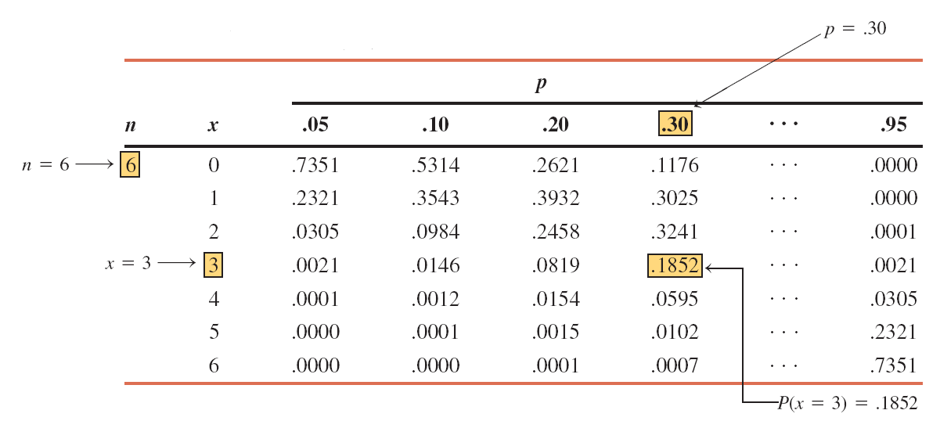
Table 5.10 Determining P(x = 3) for n = 6 and p = .30

Slide 69
Table 5.11 Portion of Table I for n = 6 and p= .30
 |  | p
n | x | .30
6 | 0 | .1176
 | 1 | .3025
 | 2 | .3241
 | 3 | .1852
 | 4 | .0595
 | 5 | .0102
 | 6 | .0007

Slide 70
Example 5-14: Solution
P(3) = .1852
P(at most 2) = P(0 or 1 or 2)
= P(0) + P(1) + P(2)
= .1176 + .3025 + .3241 = .7442
P(at least 3) = P(3 or 4 or 5 or 6)
= P(3) + P(4) + P(5) + P(6)
= .1852 + .0595 + .0102 + .0007
= .2556
P(1 to 3) = P(1) + P(2) + P(3)
= .3025 + .3241 + .1852 = .8118

Slide 71
Example 5-14: Solution Table 5.12 Probability Distribution of x for n = 6 and p = .30
(e)
x | P (x)
0 | .1176
1 | .3025
2 | .3241
3 | .1852
4 | .0595
5 | .0102
6 | .0007

Slide 72
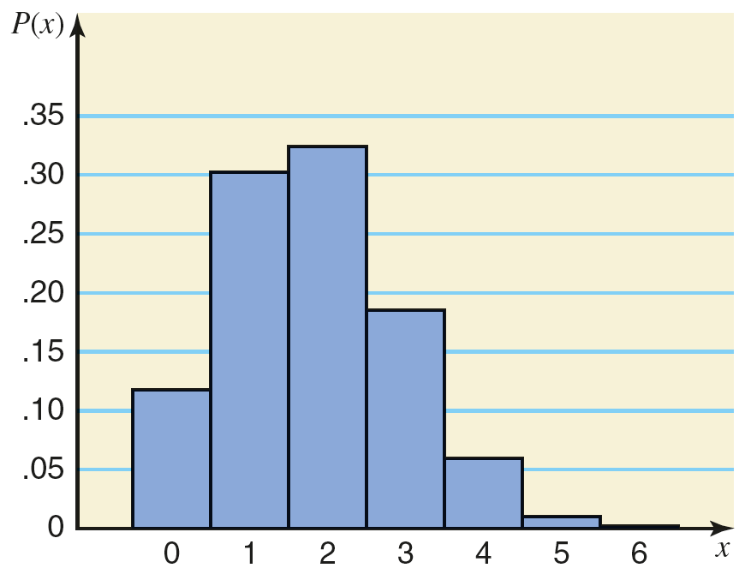
Example 5-14: Solution Figure 5.4 Histogram for the Probability Distribution of x
(e)

Slide 73
Probability of Success and the Shape of the Binomial Distribution
For any number of trials n:
The binomial probability distribution is symmetric if p =.50.
The binomial probability distribution is skewed to the right if p is less than .50.
The binomial probability distribution is skewed to the left if p is greater than .50.

Slide 74
Table 5.13 Probability Distribution of x for n = 4 and p = .50
x | P (x)
0 | .0625
1 | .2500
2 | .3750
3 | .2500
4 | .0625

Slide 75
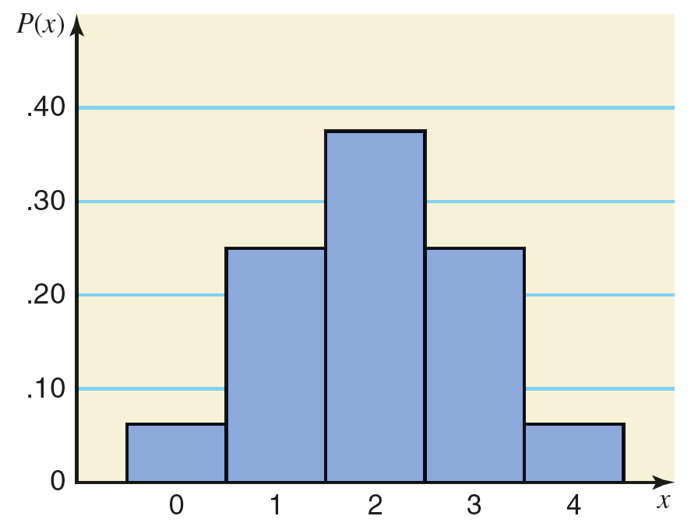
Figure 5.5 Histogram for the Probability Distribution of Table 5.13

Slide 76
Table 5.14 Probability Distribution of x for n = 4 and p = .30
x | P (x)
0 | .2401
1 | .4116
2 | .2646
3 | .0756
4 | .0081

Slide 77
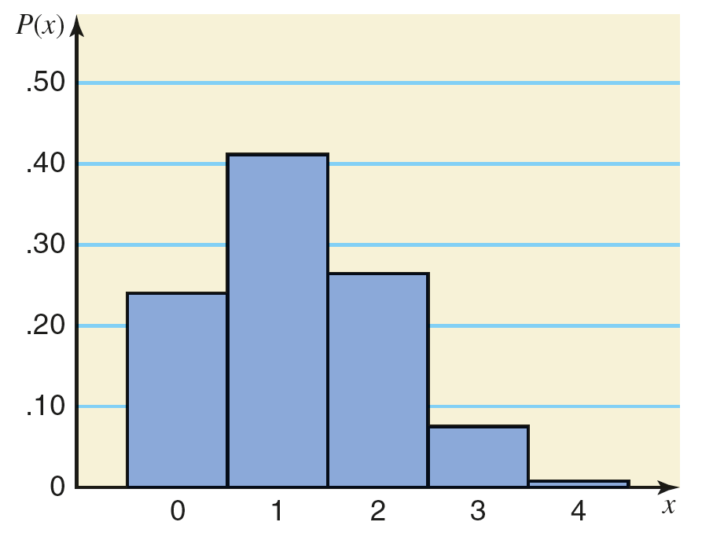
Figure 5.6 Histogram for the Probability Distribution of Table 5.14

Slide 78
Table 5.15 Probability Distribution of x for n = 4 and p = .80
x | P (x)
0 | .0016
1 | .0256
2 | .1536
3 | .4096
4 | .4096

Slide 79
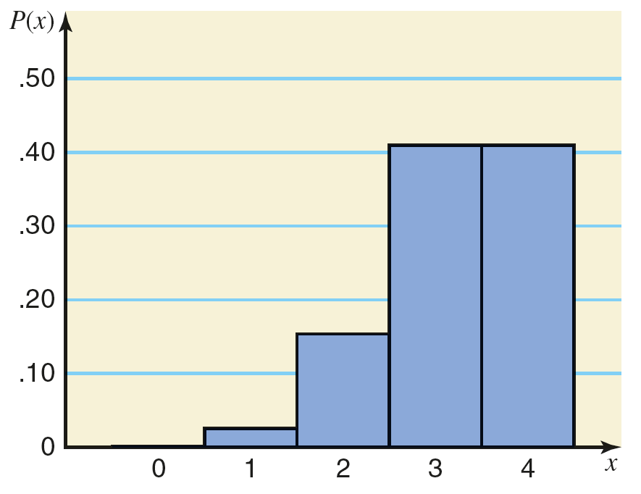
Figure 5.7 Histogram for the Probability Distribution of Table 5.15

Slide 80
Mean and Standard Deviation of the Binomial Distribution
The mean and standard deviation of a binomial distribution are, respectively,
µ = np and
where n is the total number of trials, p is the probability of success, and q is the probability of failure.

Slide 81
Example 5-15
In a Pew Research Center survey conducted during September 5–16, 2019, 90% of U.S. adults said that they had a favorable view of the U.S. postal service. Assume that this result is true for the cur-rent population of U.S. adults. A random sample of 60 U.S. adults is selected. Let x be the number of adults in this sample who have a favorable view of the U.S. postal service. Find the mean and standard deviation of the probability distribution of x.

Slide 82
Example 5-15: Solution
n = 60, p = .90, and q = .10
Using the formulas for the mean and standard deviation of the binomial distribution,
µ = np = 60(.90) = 54

Slide 83
5.5. The Hypergeometric Probability Distribution
Let
N = total number of elements in the population
r = number of successes in the population
N – r = number of failures in the population
n = number of trials (sample size)
x = number of successes in n trials
n – x = number of failures in n trials

Slide 84
The Hypergeometric Probability Distribution
The probability of x successes in n trials is given by

Slide 85
Example 5-16
Brown Manufacturing makes auto parts that are sold to auto dealers. Last week the company shipped 25 auto parts to a dealer. Later, it found out that 5 of those parts were defective. By the time the company manager contacted the dealer, 4 auto parts from that shipment had already been sold. What is the probability that 3 of those 4 parts were good parts and 1 was defective?

Slide 86
Example 5-16: Solution
N = 25, r = 20, N – r = 5, n = 4, x = 3, n – x = 1
Thus, the probability that three of the four parts sold are good and one is defective is .4506.

Slide 87
Example 5-17
Dawn Corporation has 12 employees who hold managerial positions. Of them, 7 are female and 5 are male. The company is planning to send 3 of these 12 managers to a conference. If 3 managers are randomly selected out of 12,
Find the probability that all 3 of them are female
Find the probability that at most 1 of them is a female

Slide 88
Example 5-17: Solution (1 of 2)
(a)
N = 12, r = 7, N – r = 5, n = 3, x = 3, n – x = 0
Thus, the probability that all 3 of managers selected are female is .1591.

Slide 89
Example 5-17: Solution (2 of 2)
(b)
N = 12, r = 7, N – r = 5, n = 3, x = 0 and 1, n – x = 3
P(x ≤ 1) = P(0) = P(1) = .0455 + .3182 = .3637
Thus, the probability that at most 1 of 3 managers selected is female is .3637.

Slide 90
5.6 The Poisson Probability Distribution
Using the Table of Poisson probabilities
Mean and Standard Deviation of the Poisson Probability Distribution

Slide 91
The Poisson Probability Distribution (1 of 2)
Conditions to Apply the Poisson Probability Distribution
The following three conditions must be satisfied to apply the Poisson probability distribution.
x is a discrete random variable.
The occurrences are random.
The occurrences are independent.

Slide 92
Examples of Poisson Probability Distribution
The number of accidents that occur on a given highway during a 1-week period.
The number of customers entering a grocery store during a 1–hour interval.
The number of television sets sold at a department store during a given week.

Slide 93
The Poisson Probability Distribution (2 of 2)
Poisson Probability Distribution Formula
According to the Poisson probability distribution, the probability of x occurrences in an interval is
where λ (pronounced lambda) is the mean number of occurrences in that interval and the value of e is approximately 2.71828.

Slide 94
Example 5-18
On average, a household receives 9.5 telemarketing phone calls per week. Using the Poisson distribution formula, find the probability that a randomly selected household receives exactly 6 telemarketing phone calls during a given week.

Slide 95
Example 5-18: Solution
= 0.0764

Slide 96
Example 5-19
A washing machine in a laundromat breaks down an average of three times per month. Using the Poisson probability distribution formula, find the probability that during the next month this machine will have
exactly two breakdowns
at most one breakdown

Slide 97
Example 5-19: Solution
(a) P(exactly two breakdowns
(b) P(at most 1 breakdown) = P(0 or 1 breakdown)
= .0498 + .1494 = .1992

Slide 98
Example 5-20
Cynthia’s Mail Order Company provides free examination of its products for 7 days. If not completely satisfied, a customer can return the product within that period and get a full refund. According to past records of the company, an average of 2 of every 10 products sold by this company are returned for a refund. Using the Poisson probability distribution formula, find the probability that exactly 6 of the 40 products sold by this company on a given day will be returned for a refund.

Slide 99
Example 5-20: Solution
λ = 8, x = 6
Thus, the probability is .1221 that exactly 6 products out of 40 sold on a given day will be returned.

Slide 100
Using the Table of Poisson Probabilities
The probabilities for a Poisson distribution can also be read from Table III in appendix B, the table of Poisson probabilities.

Slide 101
Example 5-21
On average, two new accounts are opened per day at an Imperial Saving Bank branch. Using Table III of Appendix B, find the probability that on a given day the number of new accounts opened at this bank will be
exactly 6
at most 3
at least 7

Slide 102
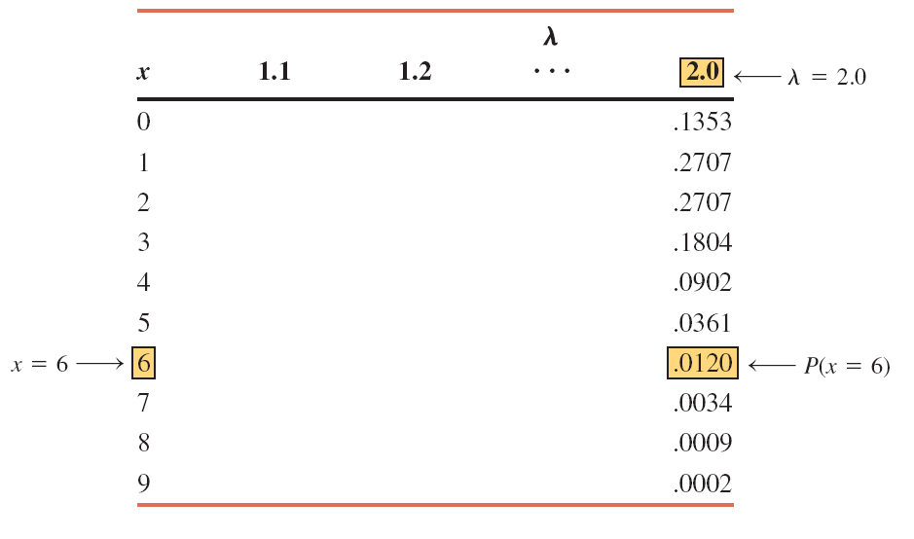
Table 5.16 Portion of Table III for λ = 2.0

Slide 103
Example 5-21: Solution
P(6) = .0120
P(at most 3) = P(0) + P(1) + P(2) + P(3) =.1353 +.2707 + .2707 + .1804 = .8571
P(at least 7) = P(7) + P(8) + P(9) = .0034 + .0009 + .0002 = .0045

Slide 104
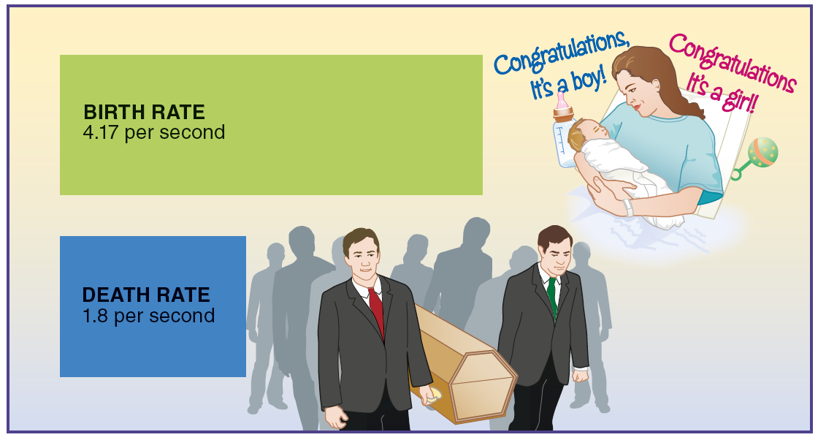
Case Study 5-2 Global Birth and Death Rates
Data source: The International Data Base and U.S. Census Bureau.

Slide 105
Example 5-22 (1 of 2)
An auto salesperson sells an average of .9 car per day. Let x be the number of cars sold by this salesperson on any given day. Using the Poisson probability distribution table, write the probability distribution of x. Draw a graph of the probability distribution.

Slide 106
Example 5-22: Solution Table 5.17 Probability Distribution of x for λ = .9
x | P (x)
0 | .4066
1 | .3659
2 | .1647
3 | .0494
4 | .0111
5 | .0020
6 | .0003

Slide 107
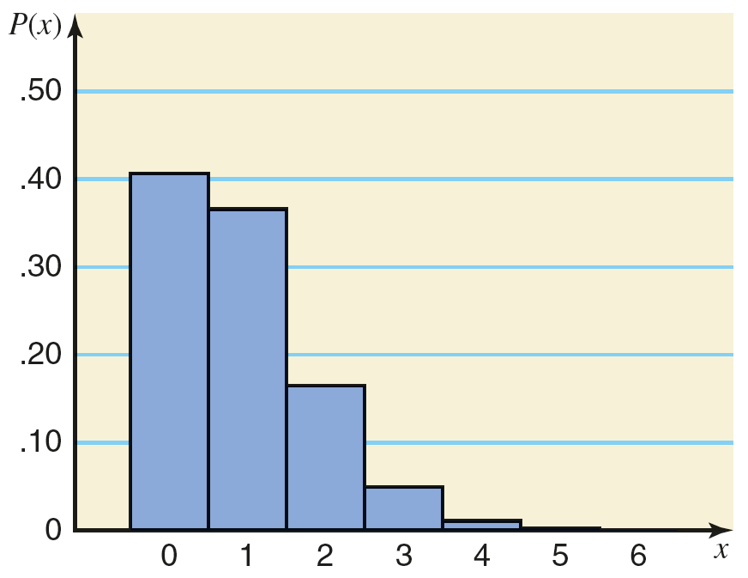
Example 5-22: Solution Figure 5.8 Histogram for the Probability Distribution of Table 5.17

Slide 108
Mean and Standard Deviation of the Poisson Probability Distribution
µ = λ
σ² = λ

Slide 109
Example 5-22 (2 of 2)
An auto salesperson sells an average of .9 car per day. Let x be the number of cars sold by this salesperson on any given day. Find the mean, variance, and standard deviation.
µ = λ = .9 Car
σ² = λ = .9

Slide 110
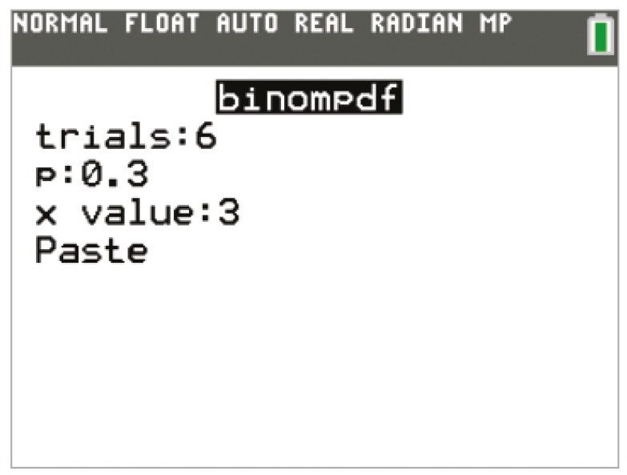
TI-84 Color/TI-84 (1 of 5)

Slide 111
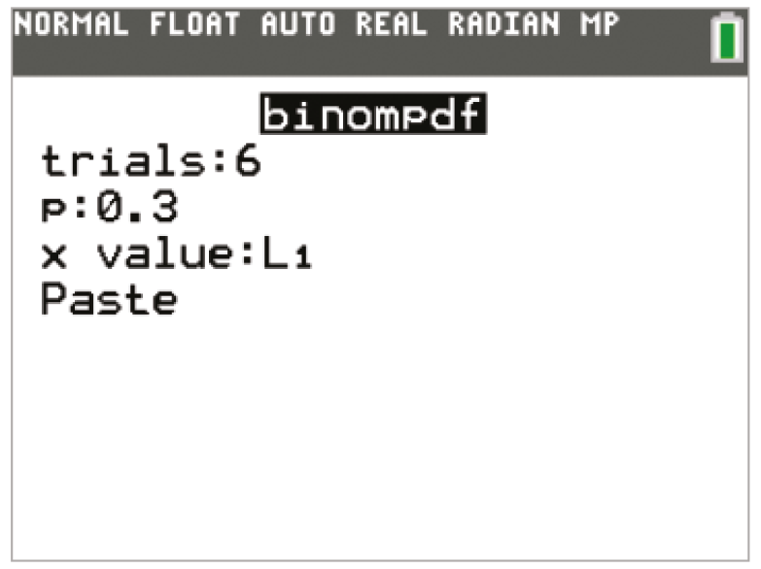
TI-84 Color/TI-84 (2 of 5)

Slide 112
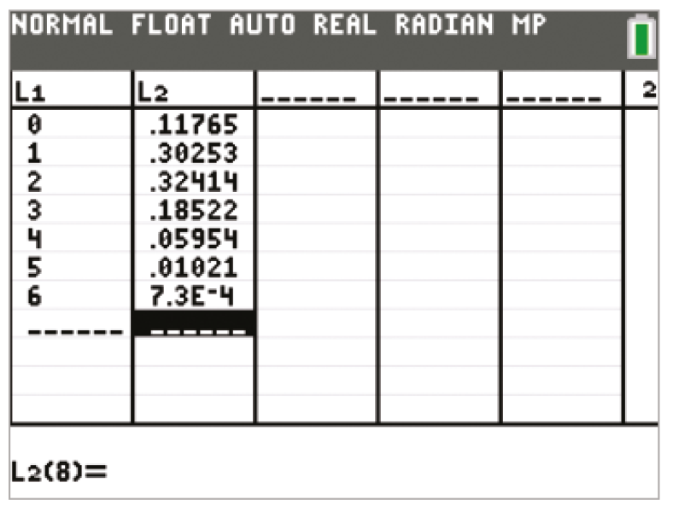
TI-84 Color/TI-84 (3 of 5)

Slide 113
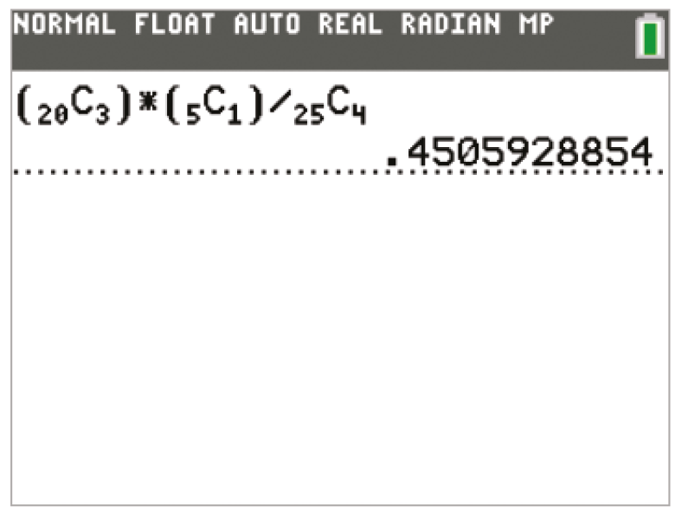
TI-84 Color/TI-84 (4 of 5)

Slide 114
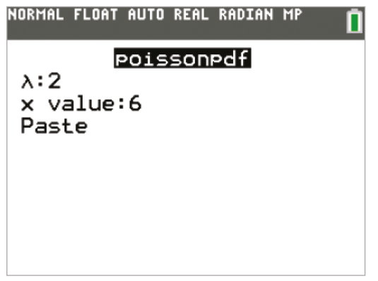
TI-84 Color/TI-84 (5 of 5)

Slide 115
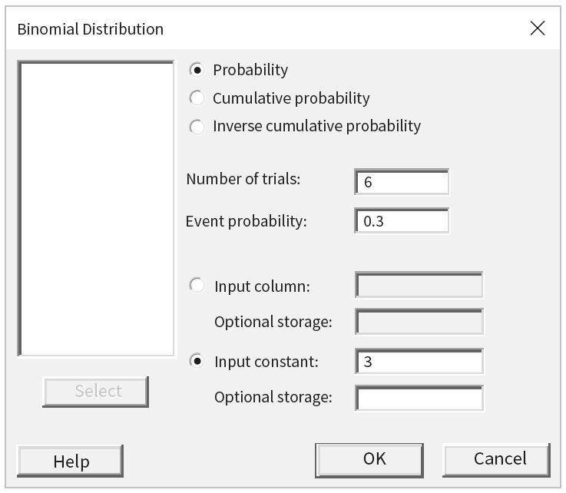
Minitab (1 of 3)

Slide 116
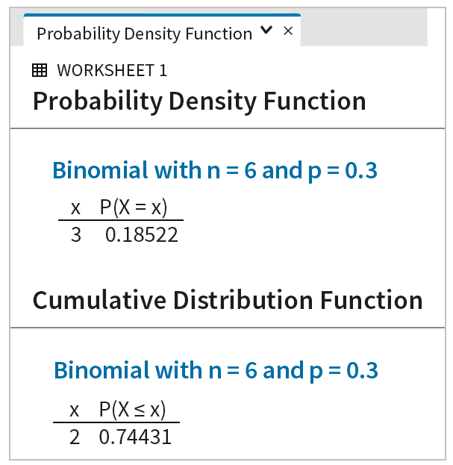
Minitab (2 of 3)

Slide 117
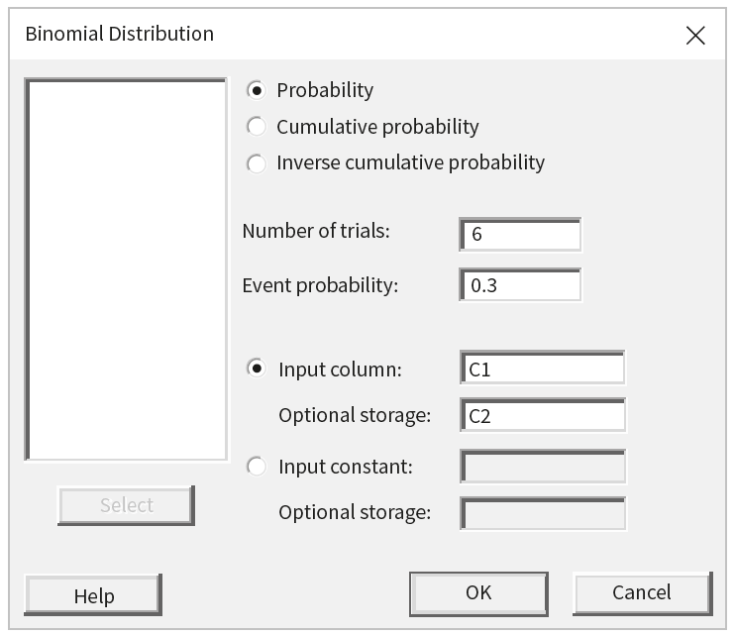
Minitab (3 of 3)

Slide 118
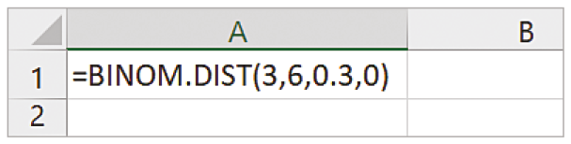
Excel (1 of 2)

Slide 119
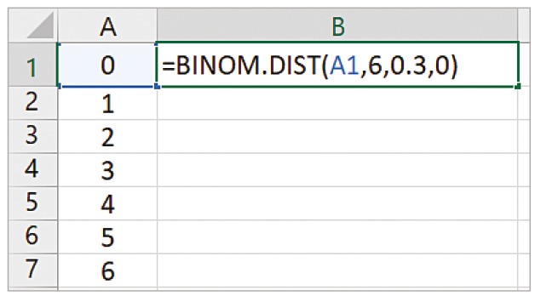
Excel (2 of 2)

Slide 120
Copyright
Copyright © 2021 John Wiley & Sons, Inc.
All rights reserved. Reproduction or translation of this work beyond that permitted in Section 117 of the 1976 United States Act without the express written permission of the copyright owner is unlawful. Request for further information should be addressed to the Permissions Department, John Wiley & Sons, Inc. The purchaser may make back-up copies for his/her own use only and not for distribution or resale. The Publisher assumes no responsibility for errors, omissions, or damages, caused by the use of these programs or from the use of the information contained herein.

